Slide 1
Diagonalization of Linear Operator
Hung-yi Lee

Slide 2
Announcement
明天 (5/5, 週四) 助教會來講解作業二
會有 bonus 的作業

Slide 3

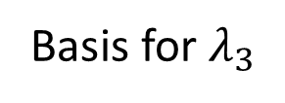
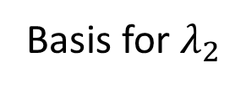
Review
$$P=\left[\begin{matrix}p_{1} & ⋯ & p_{n}\end{matrix}\right]$$
$$D=\left[\begin{matrix}d_{1} & ⋯ & 0 \\ ⋮ & ⋱ & ⋮ \\ 0 & ⋯ & d_{n}\end{matrix}\right]$$
eigenvector
eigenvalue
An n x n matrix A is diagonalizable ($A=PDP^{−1}$)
=
The eigenvectors of A can form a basis for R^{n}.
$$det\left(A−tI_{n}\right)$$
$$={\left(t−λ_{1}\right)}^{m_{1}}{\left(t−λ_{2}\right)}^{m_{2}}…{\left(t−λ_{k}\right)}^{m_{k}}\left(……\right)$$
Eigenvalue:
$$λ_{1}$$
$$λ_{2}$$
……
$$λ_{k}$$
Eigenspace:
……
Basis for $λ_{1}$
Basis for $λ_{2}$
Basis for $λ_{3}$
Independent Eigenvectors

Slide 4



Diagonalization of Linear Operator
$$T\left(\left[\begin{aligned}x_{1} \\ x_{2} \\ x_{3}\end{aligned}\right]\right)=\left[\begin{aligned}8x_{1}+9x_{2} \\ −6x_{1}−7x_{2} \\ 3x_{1}+3x_{2}−x_{3}\end{aligned}\right]$$
Example 1:
det
-t
$$A=\left[\begin{matrix}8 & 9 & 0 \\ −6 & −7 & 0 \\ 3 & 3 & −1\end{matrix}\right]$$
The standard matrix is
-t
-t
⇒ the characteristic polynomial is −(t + 1)²(t − 2)
⇒ eigenvalues: −1, 2
Eigenvalue -1:
Eigenvalue 2:
$\text{B}\text{1}$=$\left\{\left[\begin{aligned}−1 \\ 1 \\ 0\end{aligned}\right],\left[\begin{aligned}0 \\ 0 \\ 1\end{aligned}\right]\right\}$
$\text{B}\text{2}$=$\left\{\left[\begin{aligned}3 \\ −2 \\ 1\end{aligned}\right]\right\}$
⇒ B₁ ∪ B₂ is a basis of R ³
⇒ T is diagonalizable.

Slide 5


Diagonalization of Linear Operator
$$T\left(\left[\begin{aligned}x_{1} \\ x_{2} \\ x_{3}\end{aligned}\right]\right)=\left[\begin{aligned}−x_{1}+x_{2}+2x_{3} \\ x_{1}−x_{2} \\ 0\end{aligned}\right]$$
Example 2:
det
-t
$$A=\left[\begin{matrix}−1 & 1 & 2 \\ 1 & −1 & 0 \\ 0 & 0 & 0\end{matrix}\right]$$
The standard matrix is
-t
-t
⇒ the characteristic polynomial is −t²(t + 2)
⇒ eigenvalues: 0, −2
⇒ the reduced row echelon form of A − 0I₃ = A is
$$\left[\begin{matrix}1 & −1 & 0 \\ 0 & 0 & 1 \\ 0 & 0 & 0\end{matrix}\right]$$
⇒ the eigenspaces corresponding to the eigenvalue 0 has the
dimension 1 < 2 = algebraic multiplicity of the eigenvalue 0
⇒ T is not diagonalizable.

Slide 6


This lecture
Reference: Chapter 5.4
$${\left[T\right]}_{\text{B}}$$
$${\left[v\right]}_{\text{B}}$$
$${\left[T\left(v\right)\right]}_{\text{B}}$$
simple
$$B^{−1}$$
$$B$$
Properly selected
Properly selected
$$A$$
$$v$$
$$T\left(v\right)$$

Slide 7


Diagonalization of Linear Operator
If a linear operator T is diagonalizable
$$D$$
$${\left[T\right]}_{\text{B}}$$
$${\left[v\right]}_{\text{B}}$$
$${\left[T\left(v\right)\right]}_{\text{B}}$$
simple
$$P^{−1}$$
Eigenvectors form the good system
$$P$$
$$B^{−1}$$
$$B$$
Properly selected
Properly selected
$$A=PDP^{−1}$$
$$v$$
$$T\left(v\right)$$

Slide 8
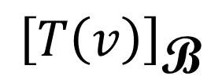
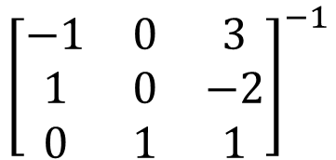
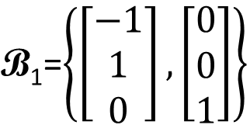
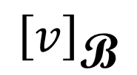
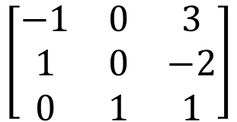
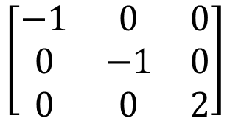
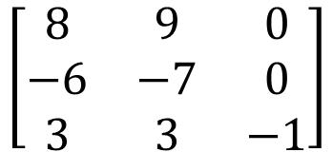
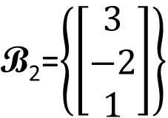
Diagonalization of Linear Operator
-1:
2:
$$T\left(\left[\begin{aligned}x_{1} \\ x_{2} \\ x_{3}\end{aligned}\right]\right)=\left[\begin{aligned}8x_{1}+9x_{2} \\ −6x_{1}−7x_{2} \\ 3x_{1}+3x_{2}−x_{3}\end{aligned}\right]$$
$\text{B}\text{1}$=$\left\{\left[\begin{aligned}−1 \\ 1 \\ 0\end{aligned}\right],\left[\begin{aligned}0 \\ 0 \\ 1\end{aligned}\right]\right\}$
$\text{B}\text{2}$=$\left\{\left[\begin{aligned}3 \\ −2 \\ 1\end{aligned}\right]\right\}$
$${\left[T\right]}_{\text{B}}$$
$${\left[v\right]}_{\text{B}}$$
$${\left[T\left(v\right)\right]}_{\text{B}}$$
$$\left[\begin{matrix}−1 & 0 & 0 \\ 0 & −1 & 0 \\ 0 & 0 & 2\end{matrix}\right]$$
$${\left[\begin{matrix}−1 & 0 & 3 \\ 1 & 0 & −2 \\ 0 & 1 & 1\end{matrix}\right]}^{−1}$$
$$\left[\begin{matrix}−1 & 0 & 3 \\ 1 & 0 & −2 \\ 0 & 1 & 1\end{matrix}\right]$$
$$\left[\begin{matrix}8 & 9 & 0 \\ −6 & −7 & 0 \\ 3 & 3 & −1\end{matrix}\right]$$
$$v$$
$$T\left(v\right)$$

Slide 9
Another Application of Eigenvector: Page Rank
Reference:
THE $25,000,000,000 EIGENVECTOR: THE LINEAR ALGEBRA BEHIND GOOGLE
http://userpages.umbc.edu/~kogan/teaching/m430/GooglePageRank.pdf
A SURVEY OF EIGENVECTOR METHODS FOR WEB INFORMATION RETRIEVAL
http://doradca.oeiizk.waw.pl/survey.pdf

